Slide 1
Programming Fundamentals
Lecture 1
Introduction and Flow Charts

Slide 2
Introduction
What I say: “Programming is fun!”
What students hear: “You are going to die miserably and in perpetual pain”

Slide 3
Introduction continued
What programming is not:
Math (sort of)
Physics
Chemistry
What programming is:
Thinking logically
Knowing the sequence
Problem solving

Slide 4
What programming can do
Gorogoa <- See what CS and Art can accomplish
Miegakure <- More proof
Still not satisfied? Maybe this would help

Slide 5
Course Breakup
Labs | 30% | 15 labs 2% each | Each lab will have take home exercises
Quizes | 36% | 6 quizes 6% each | Small 30 min quizzes to check student’s prowess
Project 1 | 7% | Ren'py Project | Students will make their own stories
Project 2 | 12% | Instructor's choice | Programming intensive project
Final | 15% | Final | Checking their overall performance in the end

Slide 6
What is Computation?
A series of instructions that help you arrive at a solution
Example:
Square root of 4 is 2
But how do we find it without a calculator?

Slide 7
Babylonion Method
You take a number say num = 6
And then you make a guess as to what the square root should be, say x = 3
y = The value of x should be substituted by y in next step
Doing it repeatedly yields a very close approximate result
num
x +
x
2

Slide 8
How does it work in a computer?
{
Memory
Instruction 01
Instruction 02
Instruction 03
…
…
…
Control Unit
Arithmetic
Logical Unit
Program Counter
Input
Output

Slide 9
How does it work in a computer?
CU controls which instruction to execute
ALU does all the mathematical operations
PC counts the number of instruction

Slide 10
Order of instructions is important
The sequence in which the instructions are executed lead to the correct answer
We need to define the flow of instruction and decide which path to take and what part to repeat
Different inputs produce different outputs and we need to take decisions accordingly

Slide 11
Flow Chart Defined
A flow chart is a graphical or symbolic representation of a process.
Each step in the process is represented by a different symbol and contains a short description of the process step.
The flow chart symbols are linked together with arrows showing the process flow direction.

Slide 12
Basic Flowchart Symbols

Slide 13

Terminator
The oval is used to represent the start and end of a process.

Slide 14

Process
A rectangular flow chart shape indicating a normal process flow step.

Slide 15
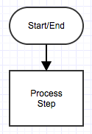
The Arrow
Represents the directional flow.
Guide the viewer along their flowcharting path

Slide 16
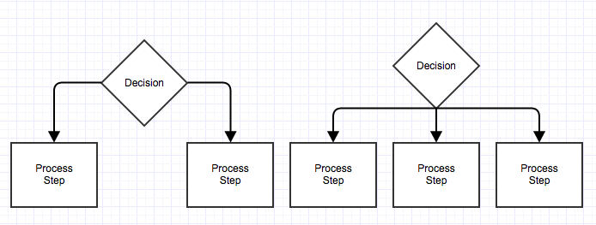
Decision
The diamond symbolizes that a decision needs to be made.

Slide 17
Connector
Used to indicate a jump in the process flow.
A

Slide 18
Document
Used to indicate a document or report.
Document

Slide 19
Data, or Input/Output
A parallelogram that indicates data input or output (I/O) for a process.
Data or Input/Output

Slide 20
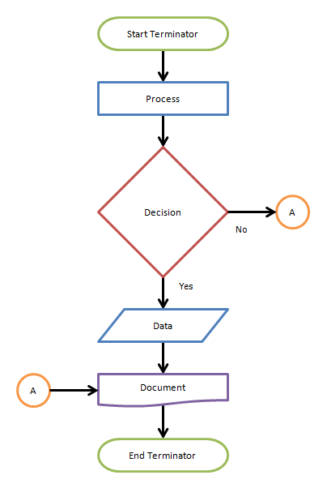
A simple flow chart showing the symbols

Slide 21
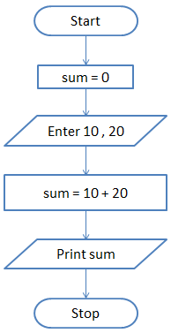
Q1. Add 10 and 20
Algorithm (in simple English)
Initialize sum = 0 (PROCESS)
Enter the numbers (I/O)
Add them and store the result in sum (PROCESS)
Print sum (I/O)

Slide 22
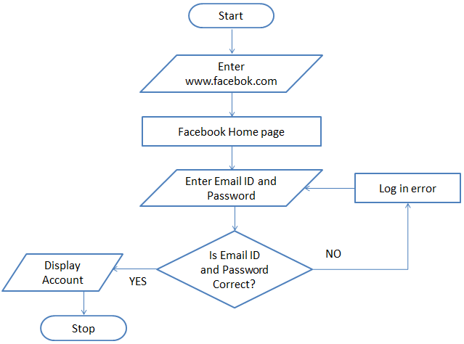
Q2. Draw a flowchart to log in to Facebook account
Algorithm (in simple English)
Enter www.facebook.com in your browser. (I/O)
Facebook Home page loads (PROCESS)
Enter your Email ID and Password (I/O)
Is Email ID and Password Valid (DECISION) if NO then Log in error (PROCESS) go to step 3 else Display facebook Account (I/O) Stop

Slide 23
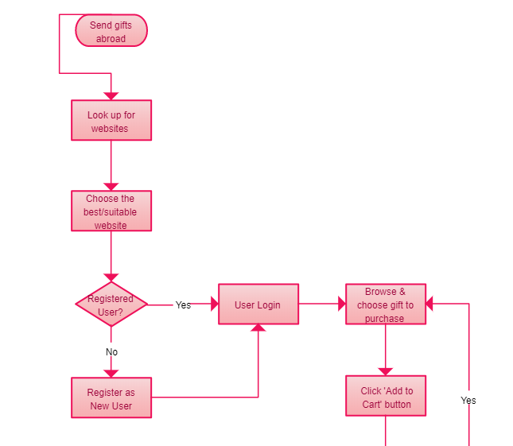
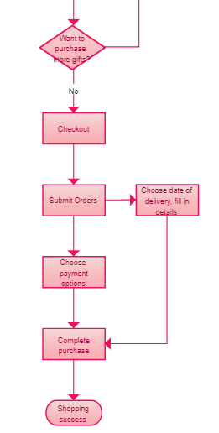

Slide 24
The End

